Slide 1

Data Mining - Advances Project 2- P3
Warsaw University Of Technology
Faculty of Mathematics and Information Systems
Ziad AL bkhetan, Neven Piculjan, Naveen Mupparapu
Winter semester - 2015

Slide 2
Plan
Introduction
Dataset Statistical Information
Clustering Statistical Information
Association Rules Statistical Information
Conclusion

Slide 3
Our Dataset
We have the logs for these 8 stations: cnk02a, cnk02b, cnk03, cnk05, cnk06, cnk07, cnk09, cnk10.
Contains 6.5 M records.
We filtered all visitors with id = -1
Create another dataset with these features:
Consumed time
start time
visit day
interactions count

Slide 4
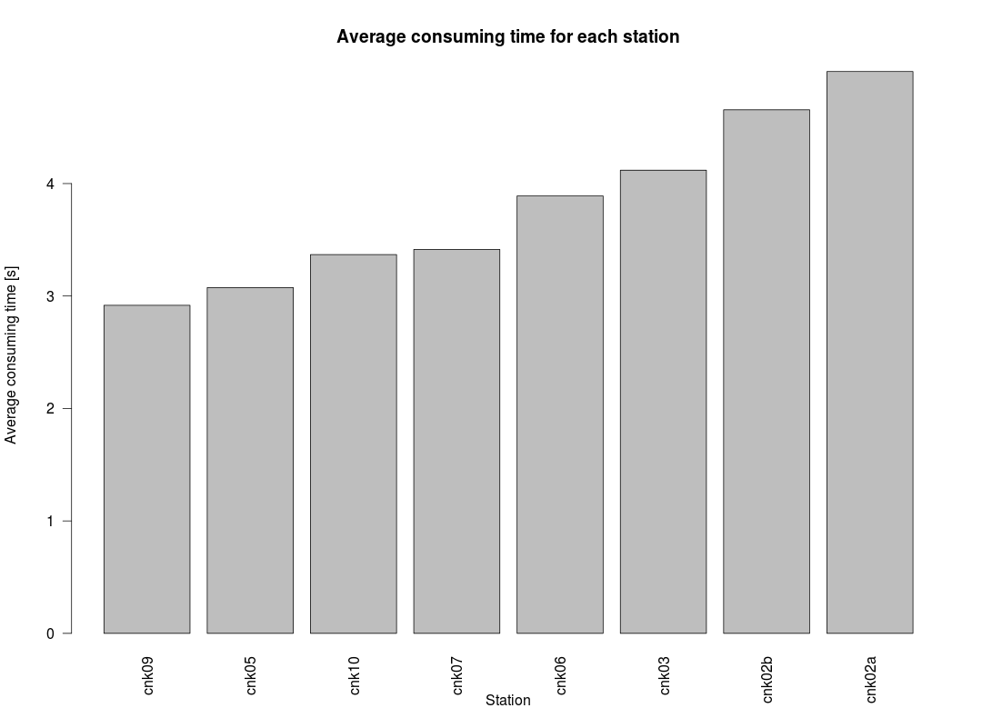
Statistical Information
cnk02a has the highest average consuming time: 4.996435
cnk09 has the lowest average consuming time: 2.917625
difference between average time for cnk02a and average time for cnk09: 2.078811
average consuming time in whole dataset is 3.667911

Slide 5
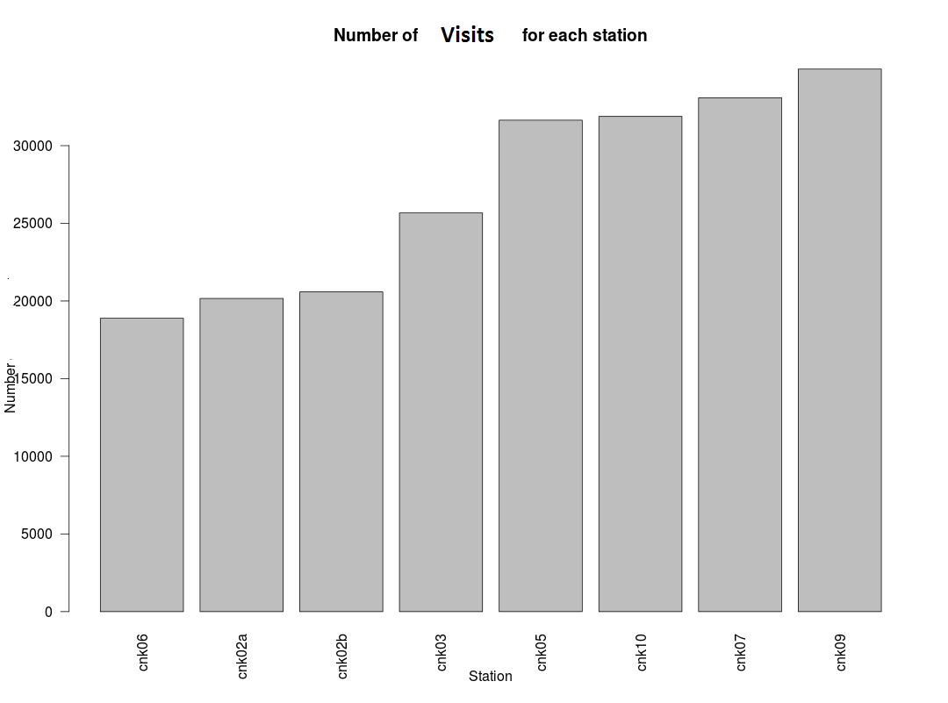
Visits In Each Stations
cnk06 has the largest number of visits: 34932
cnk06 has minimum number of visits: 18887
difference between number of visits for cnk09 and number of visits for cnk06: 16045
number of visits in whole dataset: 216843

Slide 6
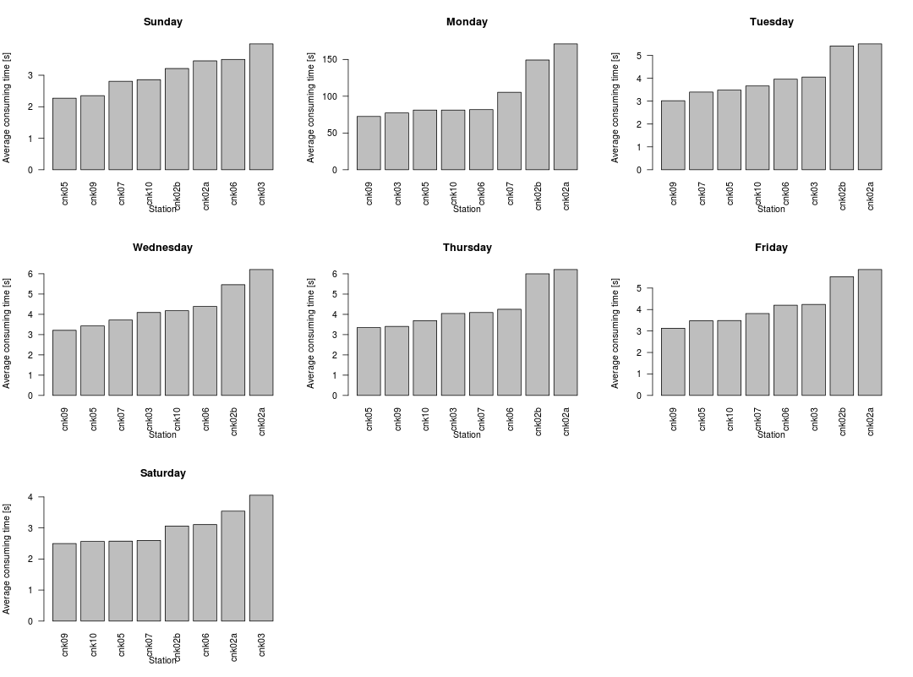
Average Consumed Time Every Day
Notes:
Sunday (41073 records)-
-cnk03 has the highest average consuming time: 3.994316
cnk05 has the lowest average consuming time: 2.271816
difference between average time for cnk03 and average time for cnk05: 1.722499 seconds
average consuming time for all stations: 2.959541 seconds.
Monday (112 records - noise)
this observation can be omitted because we know that museum is not opened on Monday and there are only few records
Tuesday (33166 records)
cnk02a has the highest average consuming time: 5.503641
cnk09 has the lowest average consuming time: 3.017689
difference between average time for cnk02a and average time for cnk09: 2.485952 seconds
average consuming time for all stations: 3.893435 seconds
Wednesday (31218 records)
cnk02a has the highest average consuming time: 6.208538
cnk09 has the lowest average consuming time: 3.212228
difference between average time for cnk02a and average time for cnk09: 2.99631 seconds
average consuming time for all stations: 4.154297 seconds
Thursday (31769 records)
cnk02a has the highest average consuming time: 6.210648
cnk09 has the lowest average consuming time: 3.347781
difference between average time for cnk02a and average time for cnk09: 2.862867 seconds
average consuming time for all stations: 4.179792 seconds.
Friday (35381 records)
cnk02a has the highest average consuming time: 5.862846
cnk09 has the lowest average consuming time: 3.128959
difference between average time for cnk02a and average time for cnk09: 2.733887 seconds
average consuming time for all stations: 4.033579 seconds
Saturday (44124 records)
cnk02a has the highest average consuming time: 4.054054
cnk09 has the lowest average consuming time: 2.497465
difference between average time for cnk02a and average time for cnk09: 1.556589 seconds
average consuming time for all stations: 2.914686 seconds
cnk02a has the highest average consuming time during whole week (Mon, Tue, Wed, Thu, Fri), and cnk02b is in the second place during those days
cnk03 has the highest average consuming time per weekend (Sat, Sun)
cnk05 has the lowest average consuming time on Thu and Sun
cnk09 has the lowest average consuming time on Mon, Tue, Wed, Fri, Sat

Slide 7
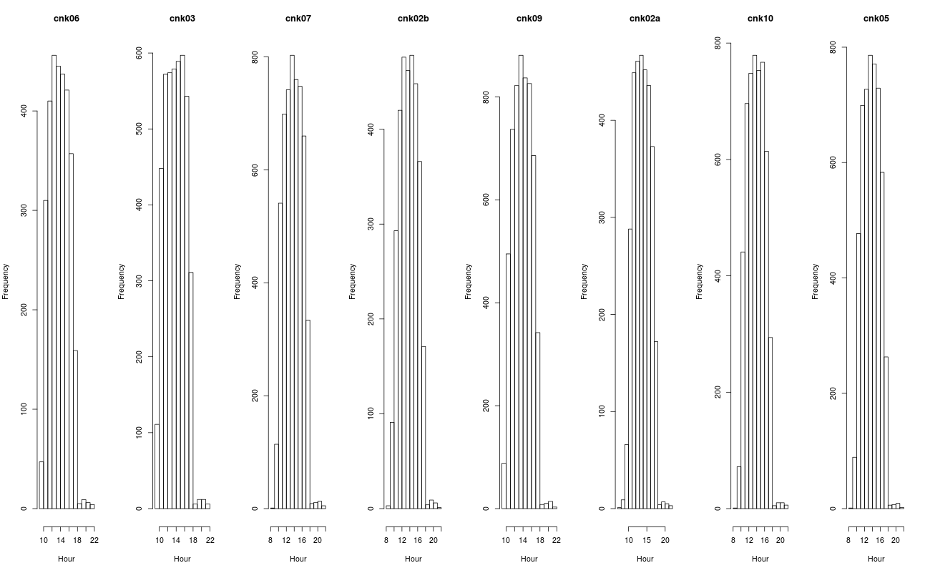
Histogram

Slide 8
Summary
for each day and for start time and for each station we plotted histograms
means and standard deviations are calculated for each histogram
again, Monday can be omitted because museum is closed on Monday
during the weekends visitors tend to use stations later than during the rest of the week
during the weekends most of the visitors visit museum at about 15:00
during the rest of the week most of the visitors visit museum at about 14:00
Notes:
Means:
cnk06 cnk03 cnk07 cnk02b cnk09 cnk02a cnk10 cnk05
Sunday 14.35340 14.47033 14.46792 14.26845 14.45967 14.256007 14.37079 14.40827
Monday 12.16976 13.26546 12.71790 12.23854 11.66198 9.058646 12.80294 12.03983
Tuesday 13.68058 13.80538 13.82107 13.64266 13.77322 13.657539 13.76832 13.81684
Wednesday 13.67958 13.78113 13.78075 13.69379 13.80406 13.702183 13.72071 13.77186
Thursday 13.63011 13.79388 13.77185 13.70384 13.83975 13.690766 13.75886 13.74630
Friday 13.73988 13.82268 13.79504 13.72794 13.84597 13.730221 13.83803 13.74263
Saturday 14.73413 14.80536 14.81400 14.66554 14.83785 14.644664 14.82101 14.77472
Standard deviations:
cnk06 cnk03 cnk07 cnk02b cnk09 cnk02a cnk10 cnk05
Sunday 2.314055 2.475582 2.387400 2.325717 2.333545 2.355663 2.323724 2.296872
Monday 2.849689 3.045327 3.974608 3.366536 4.009561 3.908453 2.778640 4.538529
Tuesday 2.081025 2.183325 2.131739 2.134395 2.061041 2.123398 2.069862 2.073896
Wednesday 2.104622 2.192900 2.157148 2.128641 2.092396 2.133458 2.058289 2.078894
Thursday 2.083463 2.189244 2.174891 2.128392 2.107875 2.159351 2.102037 2.090608
Friday 2.141710 2.259025 2.183337 2.157360 2.109304 2.159740 2.104501 2.098668
Saturday 2.258698 2.384552 2.342690 2.264176 2.252416 2.275511 2.254123 2.235153

Slide 9
Clustering
We used consumed time, start time, the day of the visit, and the interactions count in the same visit to cluster the data.
We segmented the data into four different clusters.
Visualization based on start time and consumed time.
Visualization based on the interactions count and the consumed time.
Most of the visits less than 50 min.

Slide 10
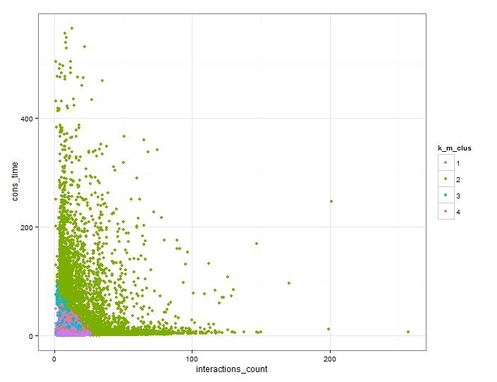
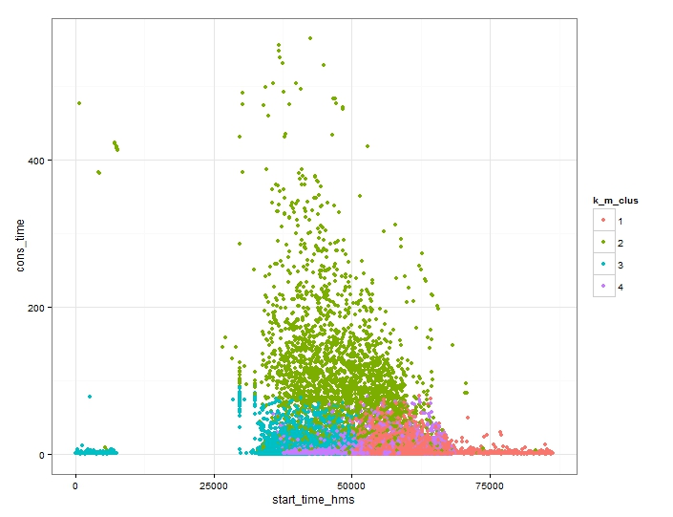
Clustering Visualization
Long consumed time and a lot of interactions
Notes:
In the first visualization (start time and consumed time):
We can see that the first cluster contains the visits with the big consumed time, and the rest depends in the start hour.
Most of the visits with small consumed time less than 60 min.
From the second plot we can see that most of the visits with small interactions number, which id related also to the long consumed time, because usually when you have a lot of interactions it means you spent long time.

Slide 11
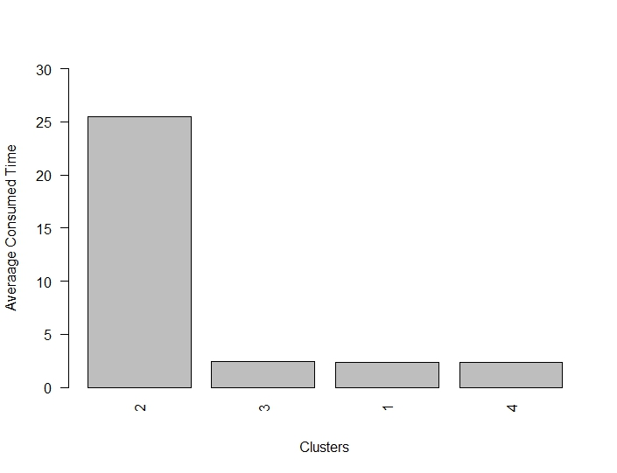
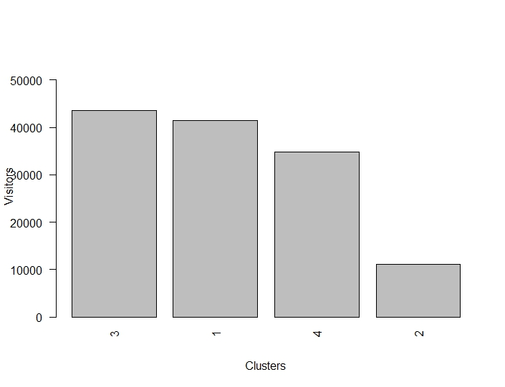
Statistics in each cluster
Notes:
Average time values:
25.508381 , 2.438154 , 2.338091 , 2.320022
Visitors Count:
43507 , 41421 , 34852 , 11148

Slide 12
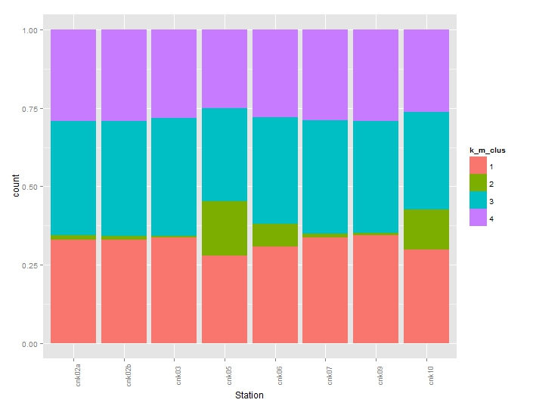
Stations in the clusters
Most of the visits with long consumed time and a lot of interactions happened in the stations cnk05, cnk10, cnk06.
The minimum number of the visits with long consumed time in the station cnk03, cnk09.
All the stations have visits with short consumed time and few interactions.
Cluster 2, long time

Slide 13
Relations Between Pages
Using Association Rules
We tried to extract the relations between the pages in the same visit.
We can use these relations to predict the target page for the customer, after visiting some pages.
It could be used to create some new dynamic links to facilitate customer navigation between the pages.

Slide 14
Some Rules
lhs rhs support confidence lift
{} => {Splash} 1.0000000 1.0000000 1.000000
{Screen} => {Splash} 0.3146742 1.0000000 1.000000
{removalWarningScene} => {Splash} 0.2238498 1.0000000 1.000000
{Menu} => {Splash} 0.2068960 1.0000000 1.000000
{Main} => {Splash} 0.1425131 1.0000000 1.000000
{ChooseOne} => {Splash} 0.1410105 1.0000000 1.000000
{Evaluation} => {ChooseOne} 0.1399953 1.0000000 7.091672
{ChooseOne} => {Evaluation} 0.1399953 0.9928007 7.091672

Slide 15
Relations Between Stations
Using Association Rules:
support is maximized
it refers to the most popular items, so it cover most of the customers needs
ten rules are shown sorted by support
it can be seen that for the most visitors, cnk02 is the first visited station
if visitor visits station cnk10, cnk05, cnk07, cnk06, cnk03 he/she will visit cnk02 afterwards
if visitor visit cnk05 and then cnk10 he/she will visit cnk02 and so on

Slide 16
Some Rules
lhs rhs support confidence lift
{} => {cnk02} 0.61377435 0.6137744 1.00000006
{cnk10} => {cnk02} 0.17342078 0.5533507 0.90155405
{cnk05} => {cnk02} 0.15851470 0.5682888 0.92589204
{cnk07} => {cnk02} 0.13013810 0.5534971 0.90179252
{cnk06} => {cnk02} 0.10569941 0.5885251 0.95886243
{cnk03} => {cnk02} 0.10294139 0.5743479 0.935763930
{cnk05,cnk10} => {cnk02} 0.07828639 0.6282896 1.023649231
{cnk09,cnk10} => {cnk02} 0.07510558 0.6201843 1.010443529
{cnk05,cnk09} => {cnk02} 0.06892585 0.6355394 1.035461128
{cnk05,cnk09} => {cnk10} 0.06179237 0.5697643 1.8180028

Slide 17
Conclusion
We could extract some patterns that the visitors followed:
Most of the long visits happened in stations cnk05, cnk06, cnk10
The visitors visited all the stations for short time.
We found that the users visited similar stations, that lead us to define some rules for this.
About 60% of visitor visited the station cnk02
We could define some relations between the visited pages during the same visit.
We found some groups of visitors who have the similar behavior based on the consumed time, and the interactions count.

Slide 18
Thank You For Listening

